Slide 1
Exploring a Skilled Trades Pathway in High School
St. Mary C.S.S. February 15, 2022
Virtual Event with Skills Ontario

Slide 2
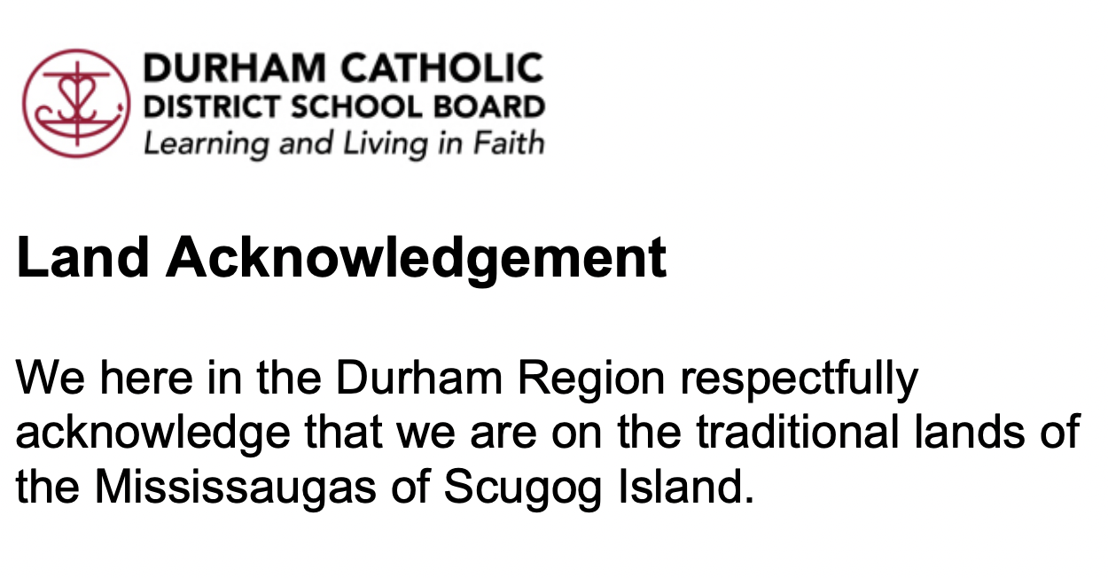

Slide 3
There are different kinds of gifts, but the same Spirit distributes them. There are different kinds of service, but the same Lord. There are different kinds of working, but in all of them and in everyone it is the same God at work.
1 Corinthians 12:4-6

Slide 4

Welcome, Angela from Skills Ontario

Slide 5

What are the Skilled Trades?
Construction: electricians, carpenters, plumbers, pipefitters, welders, heavy equipment operators, painters among others
Transportation: automotive service technicians, aviation technician, automotive painters, fuel/electrical systems and more
Manufacturing: tool and die makers, industrial mechanics (millwright), precision metal fabricators, among others
Service: horticulturalists, chefs, florists, hairstylists, early childhood educators, and more
Explore the Trades!

Slide 6
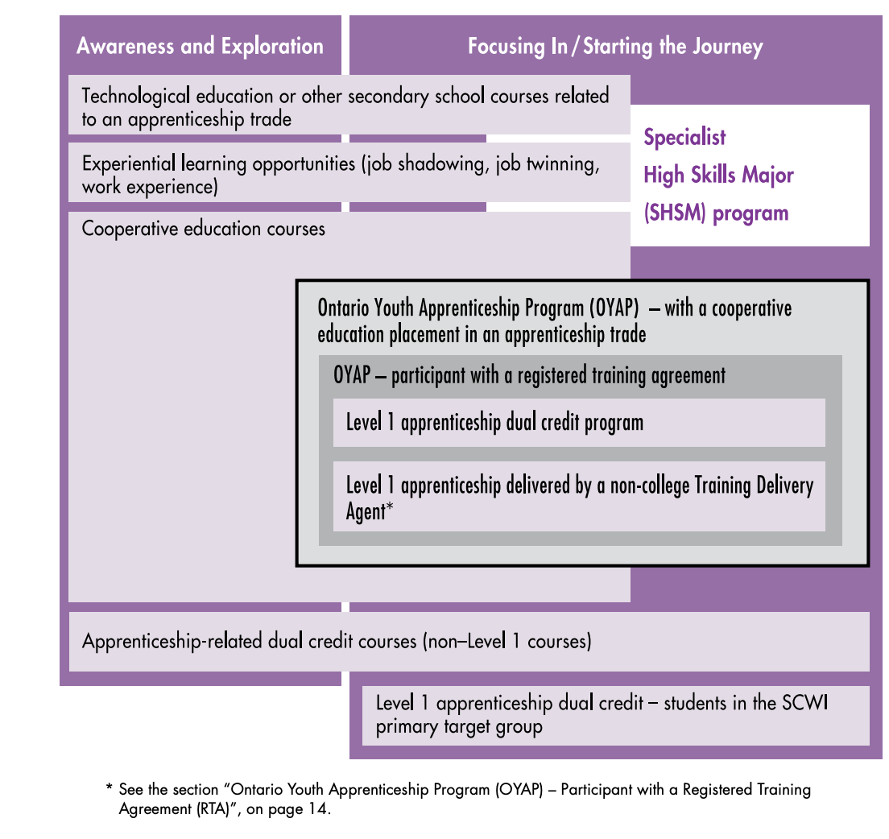
St. Mary C.S.S. Courses
Students who are considering a career in the trades, but who are unsure that this is the best path for them, or who are unsure of the trade or sector in which they might want to work, should be encouraged to participate in “Awareness and Exploration” opportunities.
Students who have decided to pursue the apprenticeship pathway, and who have an idea of the trade they are interested in, should be encouraged to participate in “Focusing In/Starting the Journey” opportunities.
Source: Pathways to Apprenticeship

Slide 7
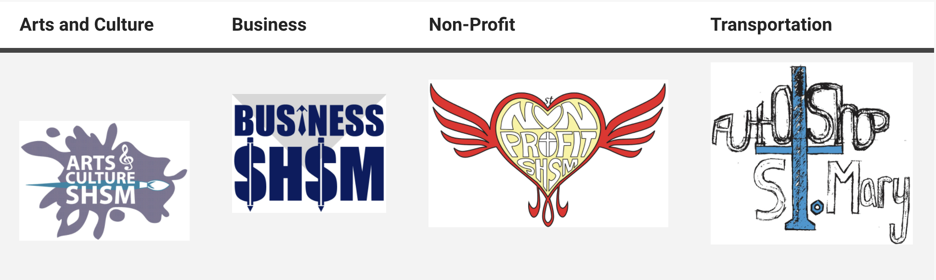

Specialist High Skills Major
A SHSM allows students to focus on knowledge and skills that are of particular importance in certain economic sectors, and to obtain certifications recognized in those sectors, as they work towards meeting the requirements for the OSSD
SHSM programs honours all pathway destinations

Slide 8
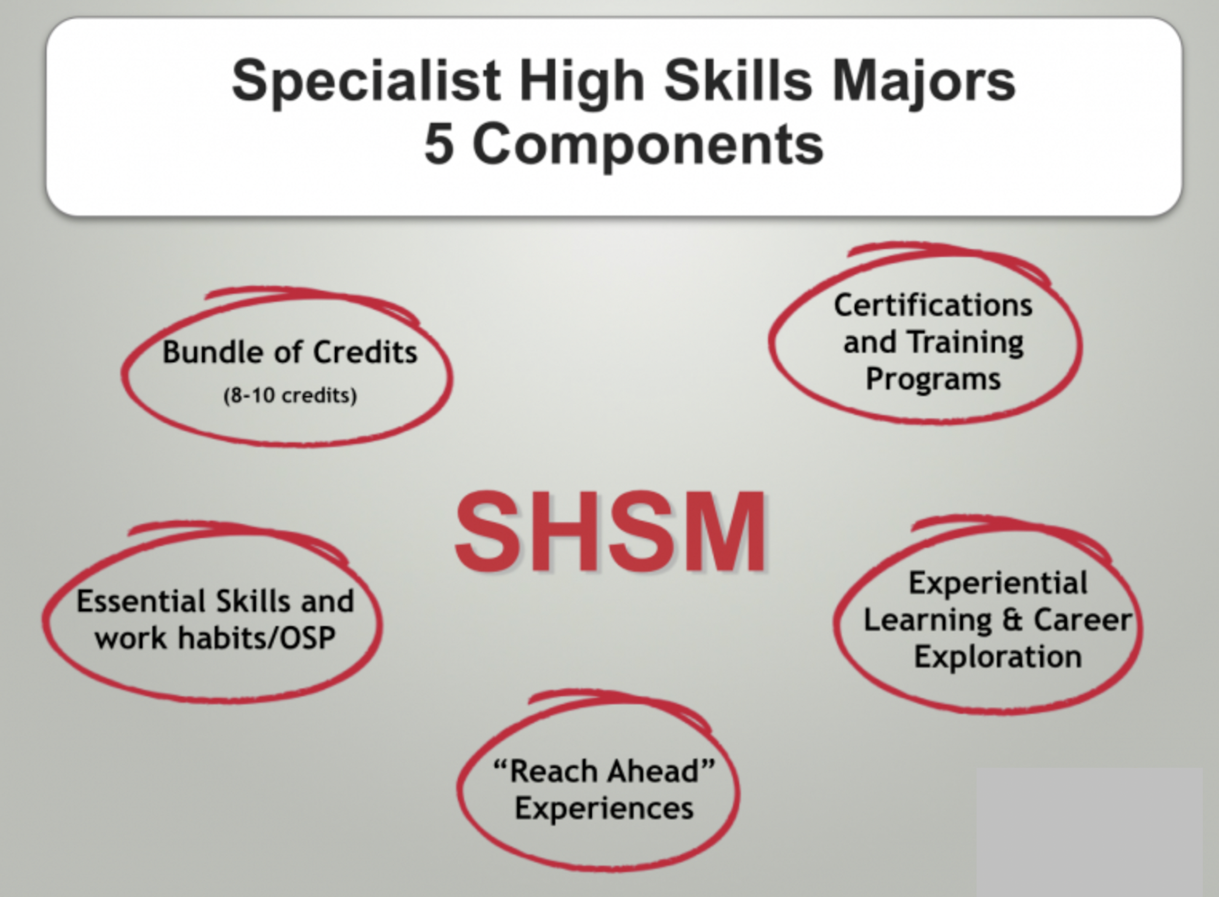

Slide 9
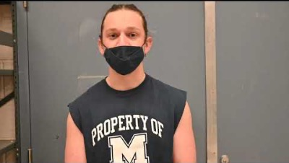
Grade 8 Skilled Trades Workshop at
St. Mary Catholic Secondary School (2021)

Slide 10
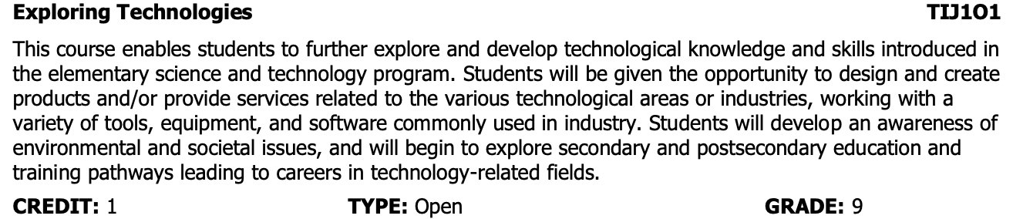
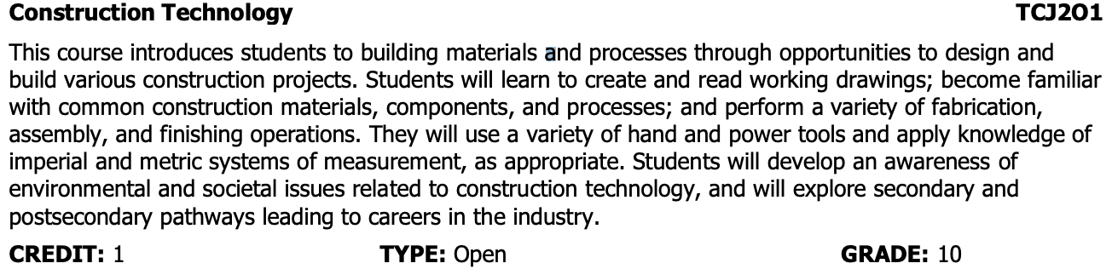

St. Mary Technological Education Courses: Construction & Industrial Power

Slide 11
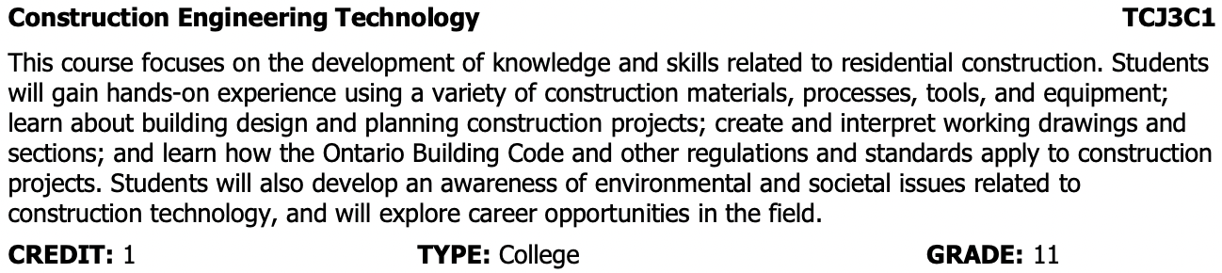
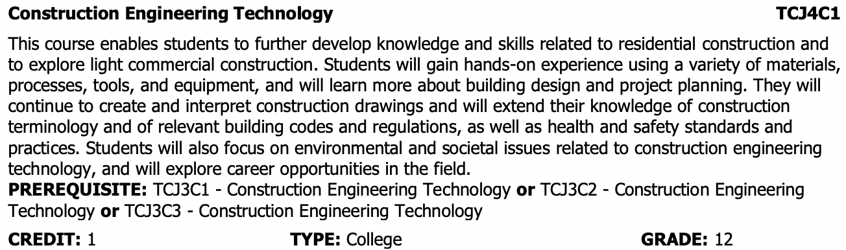
St. Mary Technological Education Courses: Construction & Industrial Power

Slide 12
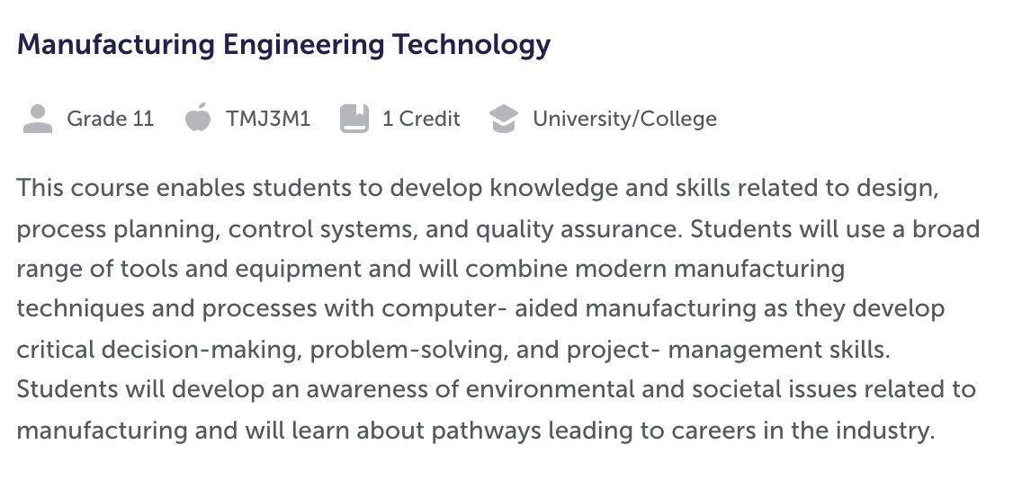
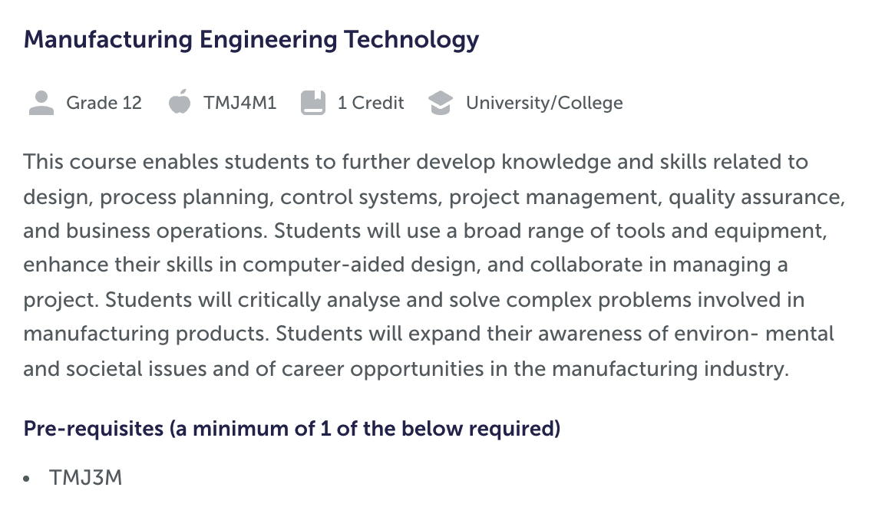
St. Mary Technological Education Courses: Construction & Industrial Power

Slide 13
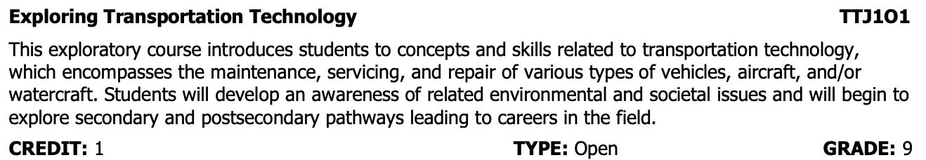
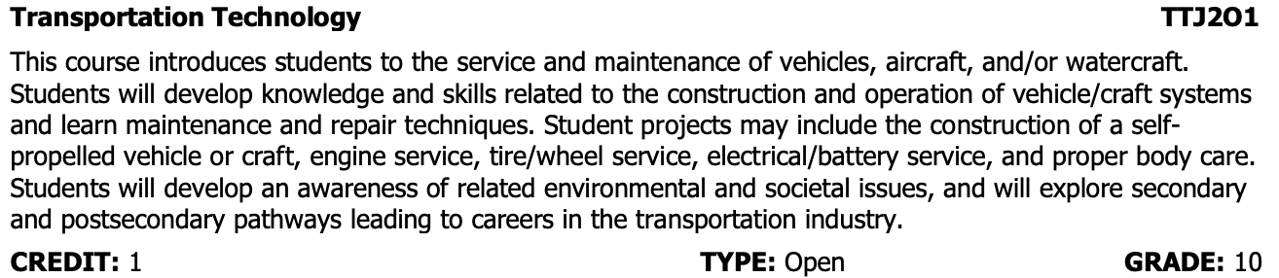
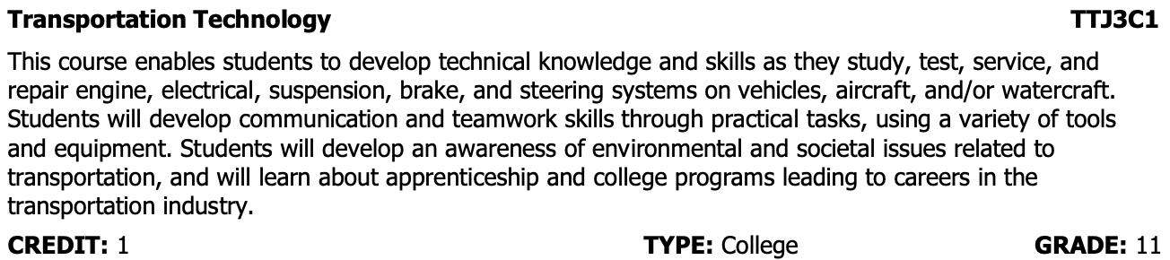
St. Mary Technological Education Courses: Motive Power (Automotive Service)

Slide 14
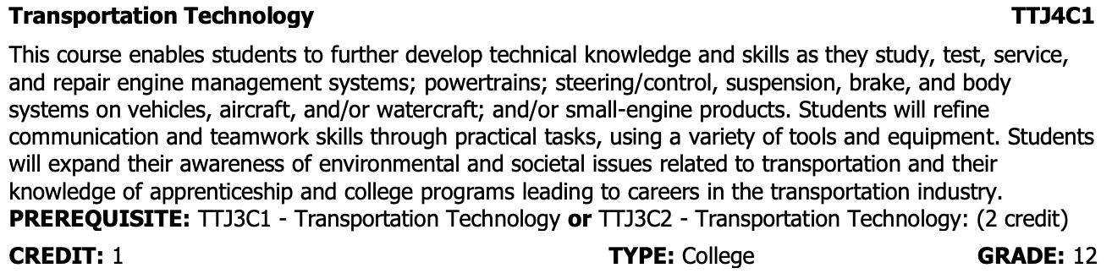
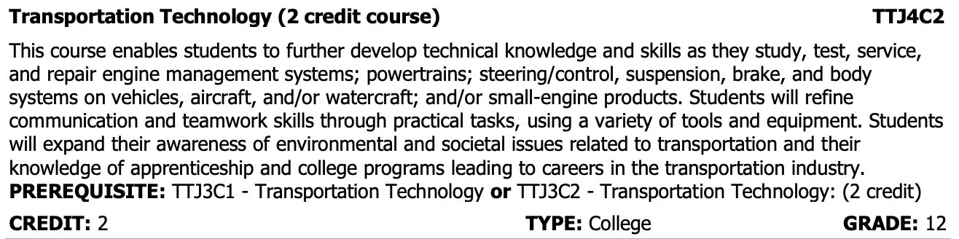
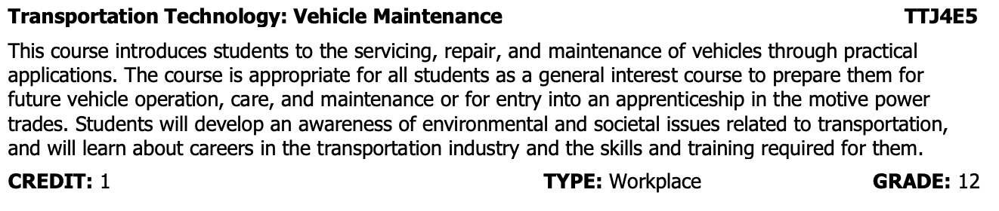
St. Mary Technological Education Courses: Motive Power (Automotive Service)

Slide 15
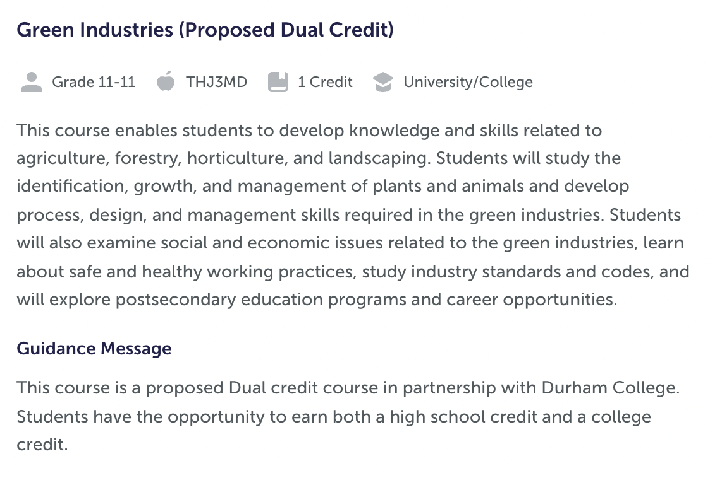
St. Mary Technological Education Courses: Green Industries - Service Courses

Slide 16
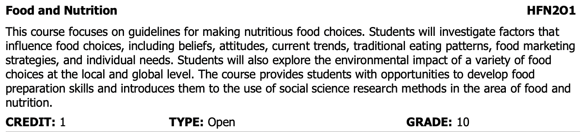
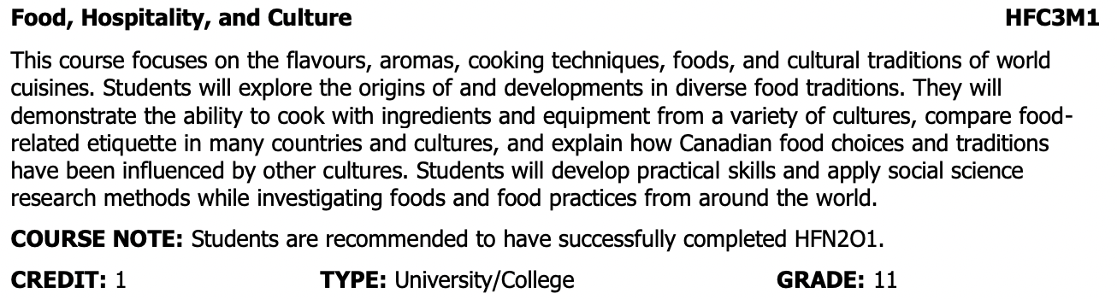
St. Mary Social Sciences/Humanities Courses: Food & Nutrition - Service Sector

Slide 17
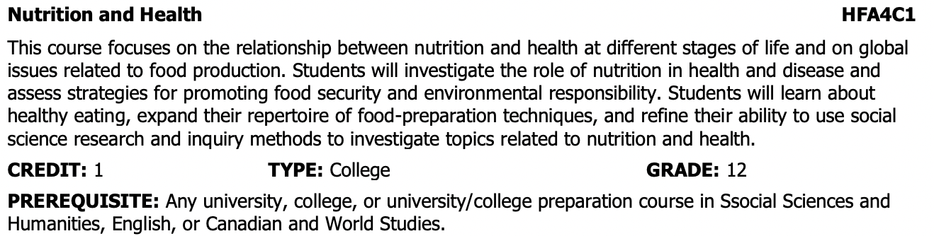
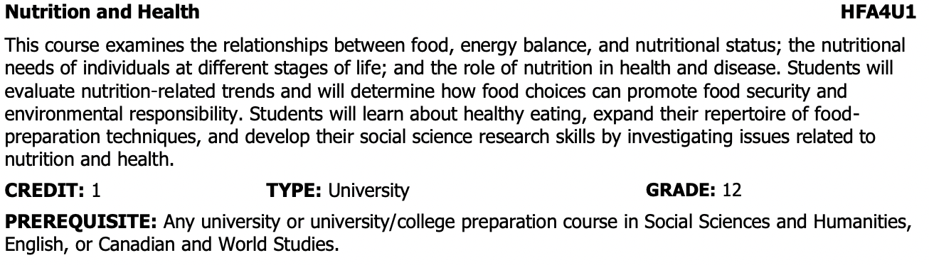
St. Mary Social Sciences/Humanities Courses: Food & Nutrition - Service Sector

Slide 18
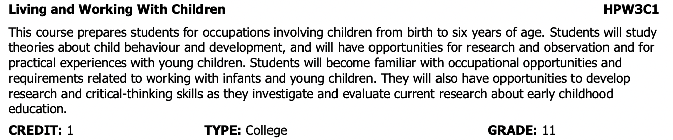
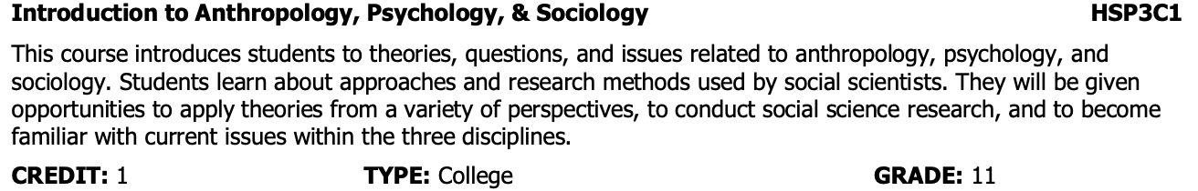
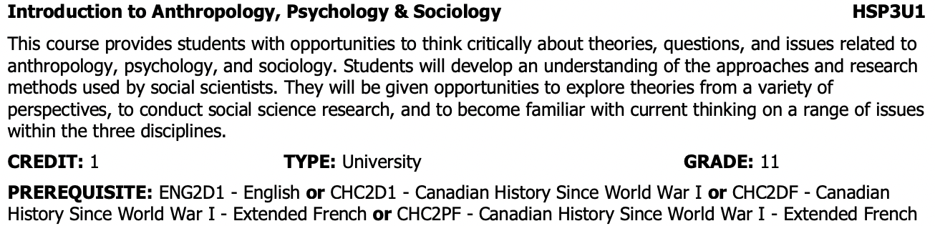
St. Mary Social Sciences/Humanities Courses: Working with Children – Service Sector

Slide 19
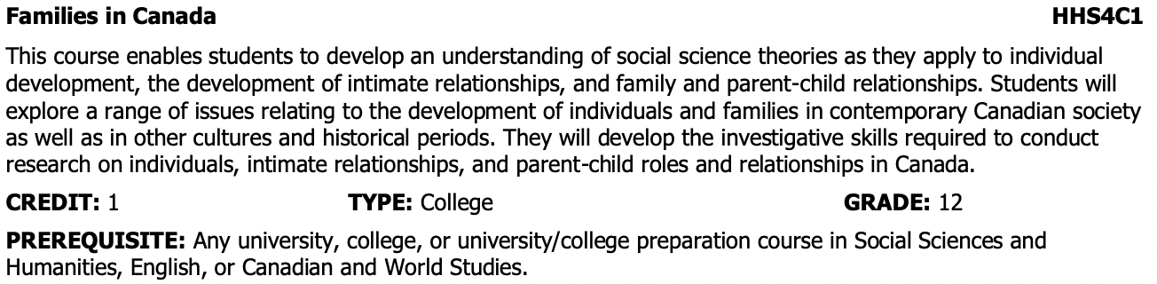
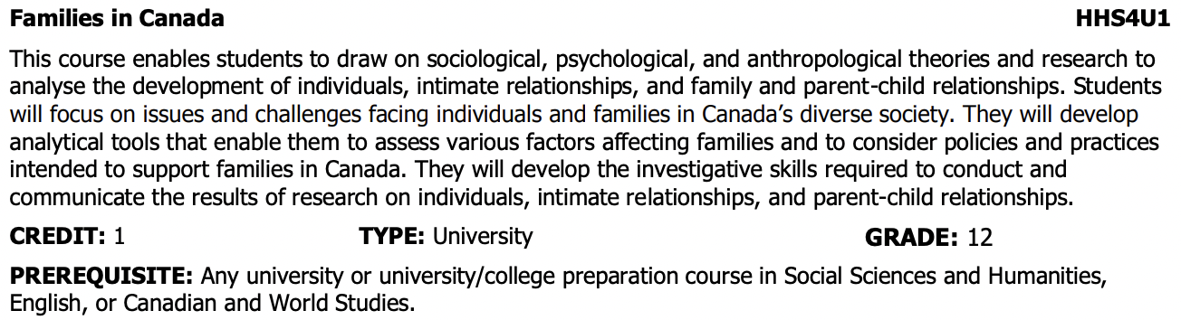
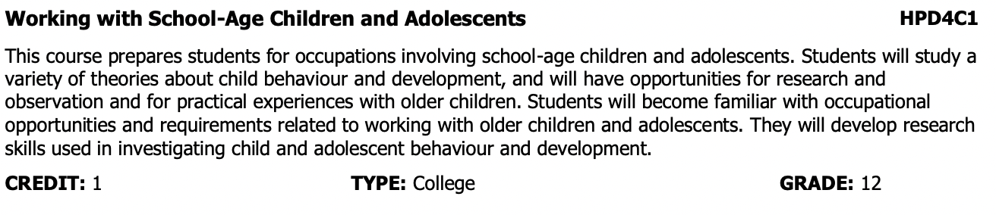
St. Mary Social Sciences/Humanities Courses: Working with Children – Service Sector

Slide 20
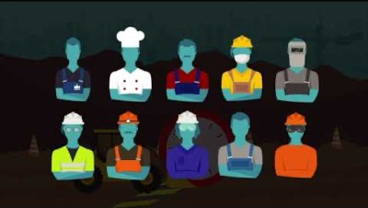
St. Mary Cooperative Education
Cooperative Education is a successful model that combines classroom learning with practical work experience.
.
Coop – 2 credits
Type: Open Grade 11 & 12
COP 20
Coop – 4 credits
Type: Open Grade 12
COP 40

Slide 21

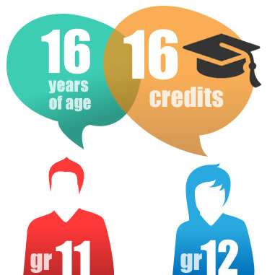
Ontario Youth Apprenticeship Program
OYAP is a Co-op program that allows students to explore and work in apprenticeship occupations.
Students have an opportunity to become registered apprentices and work towards becoming certified journeypersons in a skilled trade.
An OYAP accelerated program offers a student the opportunity to earn high school credits, college credits, register as an apprentice, complete part or all of Level One apprenticeship schooling in a specific trade, and earn hours towards his or her apprenticeship training.

Slide 22
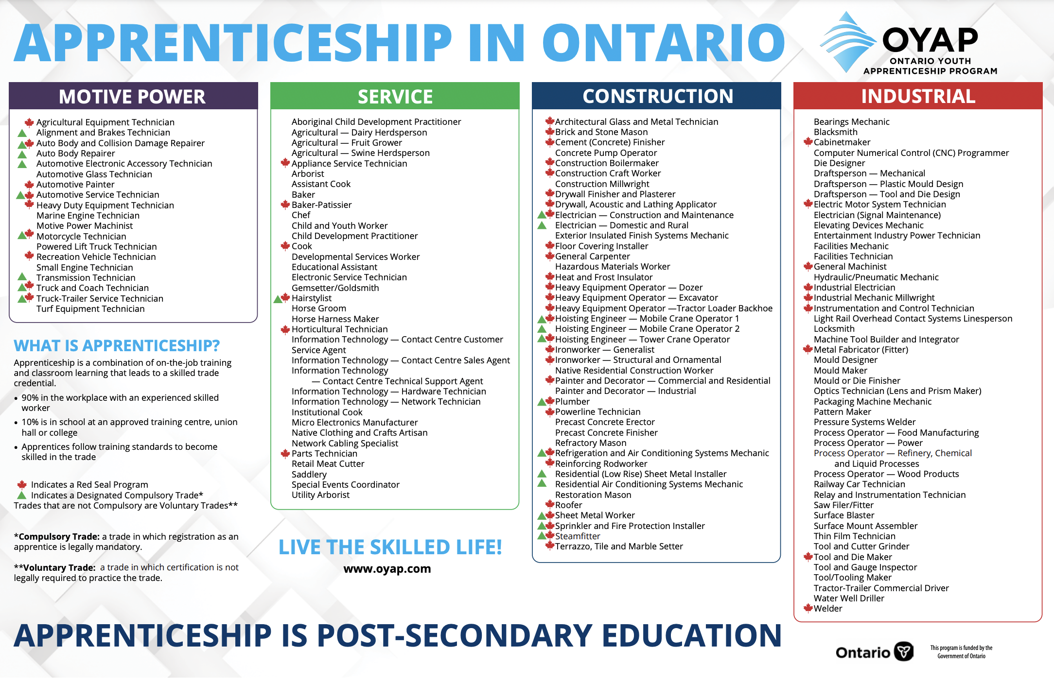

Slide 23
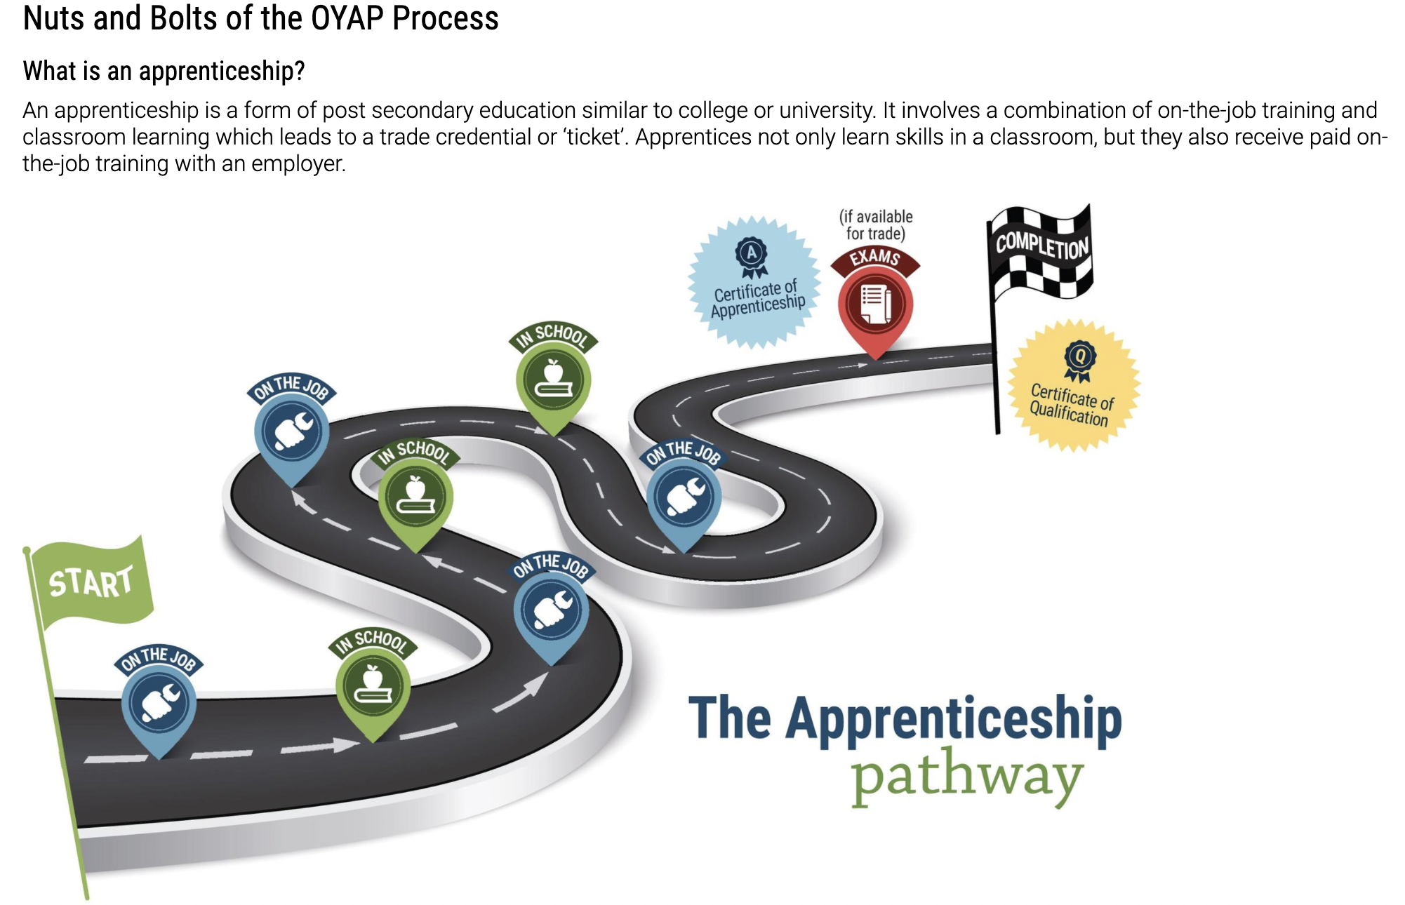
The Apprenticeship Pathway

Slide 24



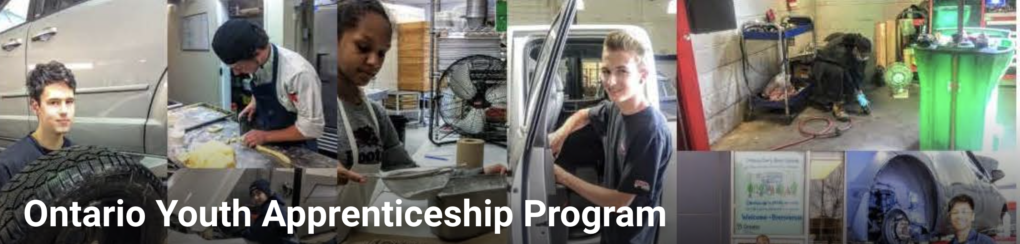
OYAP & Apprenticeship
EARN WHILE YOU LEARN!

Slide 25
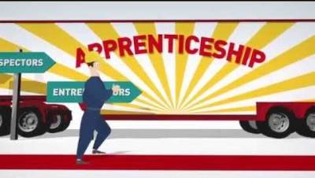
Canadian Apprenticeship Forum: Apprenticeship 101

Slide 26
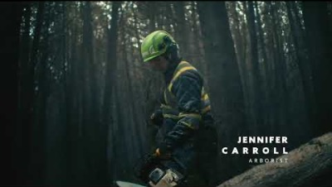
Graduate with a RESUME along with your diploma!

Slide 27
Skilled Trades Resources
Apprenticeship Search
Canadian Apprenticeship Forum
Careers in Trades
Ontario Youth Apprenticeship Program – Program Guide
OYAP
OYAP – Durham Catholic District School Board
Skills Ontario
Trade Ability
M. Wilson-Clark
Melissa.WilsonClark@dcdsb.ca

